Slide 1


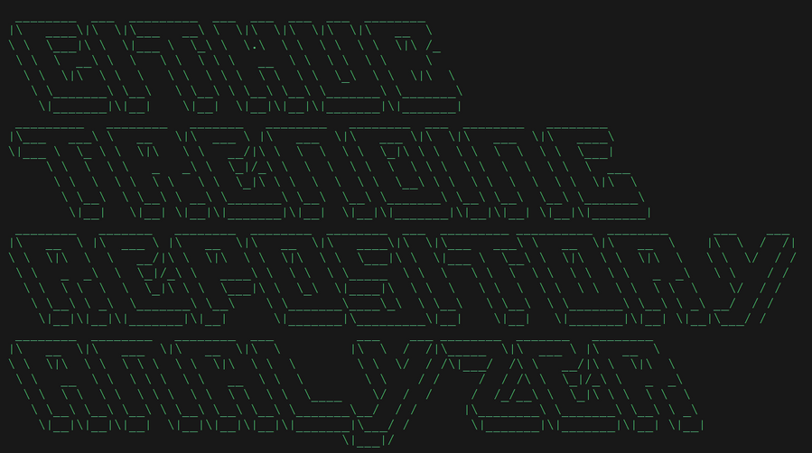
An AI-Powered GitHub Repo Analyzer Web App
ALL THE CODE ARE CONTAIN IN A SINGLE PYTHON FILE (TO AVOID ANY MISCONCEPTION)
CREATED BY FABIO CANAVARRO
FROM PRIME ONE SCHOOL

Slide 2



PROBLEM STATEMENT
In the rapidly evolving landscape of technology, staying informed about the most significant trends is crucial for developers and consumers alike. However, the abundance of information and the dynamic nature of technological advancements make it challenging to accurately identify and track the most impactful trends.

Slide 3



OUR SOLUTION
By leveraging web scraping, data analysis techniques, and natural language processing, your code can efficiently extract relevant information from a large number of repositories and generate informative summaries. This enables developers and consumers to stay up-to-date with the latest trends in the software development landscape without the need for manual analysis.

Slide 4


HOW DOES IT WORK?

Slide 5

NOTABLE SIDE FEATURES
The program has a few notable main side features aside from its main features:
GET THE LATEST INFORMATION WEEKLY. (IT WILL UPDATE THE LOCAL DATABASE)
SORTABLE AND INTERACTIVE DATA VISUALIZATION ELEMENTS (CHARTS AND TABLE)
WEB UI WITH A SLEEK DESIGN FOR MORE ACCESSIBILITY
DYNAMIC LOADING (TO REDUCE THE COMPUTATIONAL COST)
AI-GENERATED INSIGHTS
Each product is designed to enhance business performance, security, and agility.

Slide 6


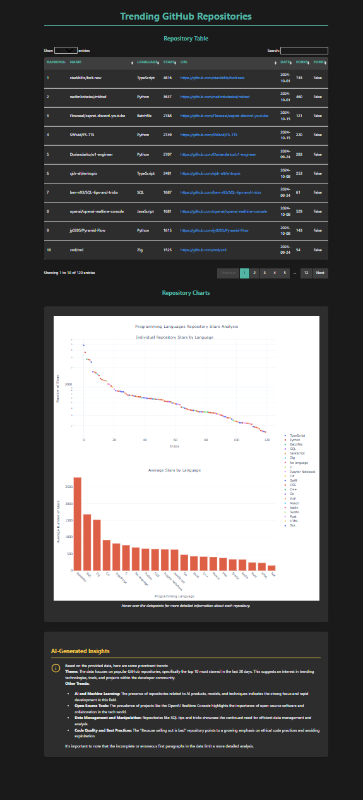
WEB
DEMO
WEBSITE DESIGN
PREVIEW
The web app color scheme is inspired heavily by leetcode color scheme

Slide 7



TECH STACK
Front end Libraries
Misc Library
flask
pandas
plotly
google
markdown
Manim (For making the Animation in slide 4)
Languages
Back end Libraries
Python (Main)
HTML (in flask rendering script)
CSS (in flask rendering script)
Javascript (in flask rendering script)
requests
numpy
json
beautiful soup
webbrowser
threading
contextlib
time
sys
colorrama
datetime

Slide 8


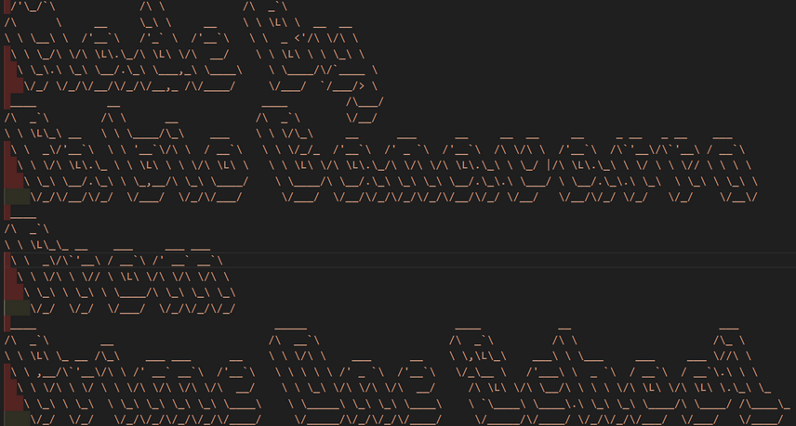
Github link: https://github.com/FabioCanavarro/GithubWebScraperAnalysis
THANK YOU!
FOR TUNING INTO THIS PRESENTATION.

